Slide 1



Challenging Ourselves: The Evolving Role of Professionals in Employment of People with Disabilities
David Hoff
Institute for Community Inclusion
UMass Boston
www.communityinclusion.org
617-480-9230
david.hoff@umb.edu

Slide 2
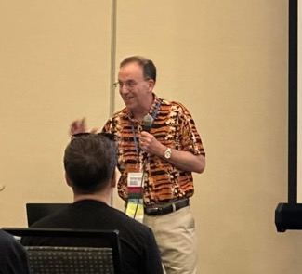
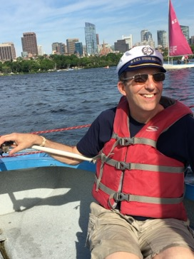
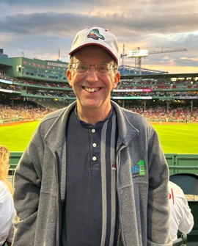
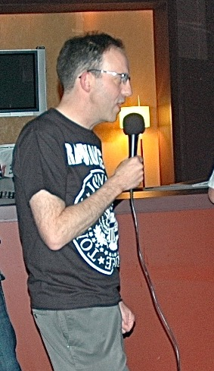
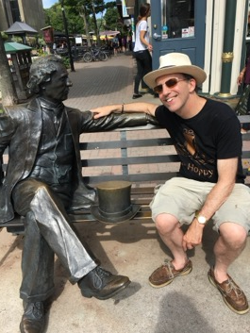
About Me
Notes:
Technical expert, SME, advocate, alliy. Not idnenttify as a PWD. Members of extended family with disabilities, I do not have personal experience as a parent, sibling, or caretake of someone with a disability. Never pretend to speak for or represernt people with disabilities. Immersed in work over 3 decades: direct service, admininistrater, training and TA. Level of discomfort, and that’s okay. Need to challenge ourselves

Slide 3
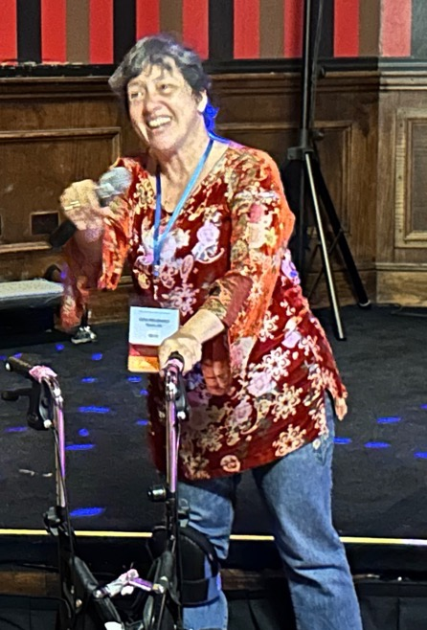
Lora Brugnaro
National APSE 2024
“ You are amazing! I don’t know what
each one of you does but I see your
dedication to my community.
You are a huge part of why we, people
with disabilities, are not forgotten,
overlooked and made invisible.
You support our efforts to hold a
productive place in society.”

Slide 4

History Lesson

Slide 5



Going Back in Time
The Roots of Our Employment System
This Photo by Unknown Author is licensed under CC BY-NC-ND
This Photo by Unknown Author is licensed under CC BY
This Photo by Unknown Author is licensed under CC BY-ND
6

Slide 6
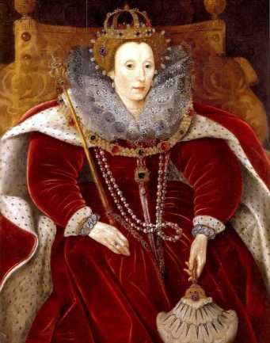
1601
Elizabethan
Poor Laws
Enacted to aid
“deserving poor, orphaned, and crippled”
Persons with disabilities labeled as “helpless poor” entitled to money and food from society, paid for through a tax on land owners
This Photo by Unknown Author is licensed under CC BY-NC-ND
7

Slide 7

1750
Act Passed by New England Colony of Connecticut
Persons with disabilities should be cared for by their closest relative.
If such a person had no relative then the town or the colony itself took direct responsibility.
8

Slide 8
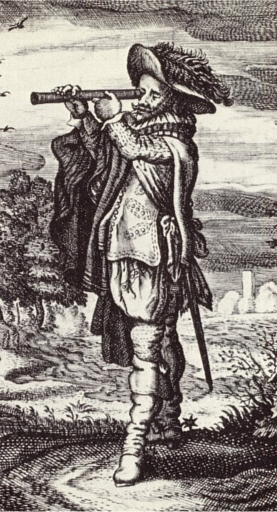
The Old View
Employment of People with Disabilities
9

Slide 9

Significant Disability Equals Unemployable in General Workforce
Significant Disability
=
10

Slide 10
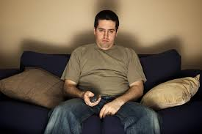
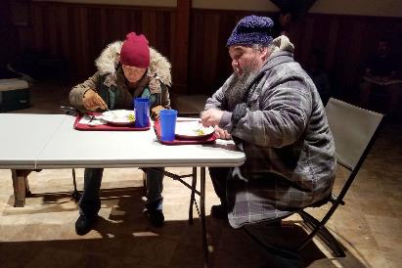
Unemployed

Slide 11
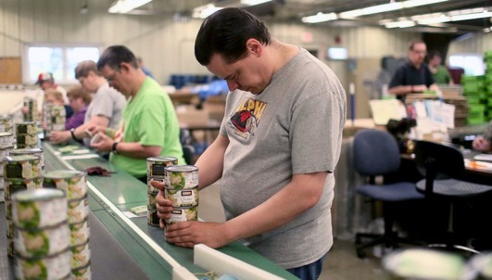
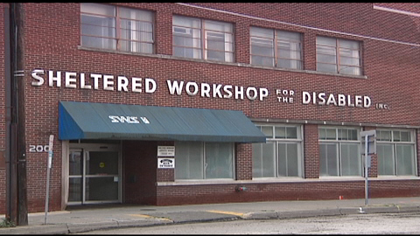
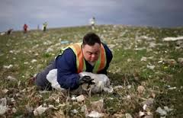
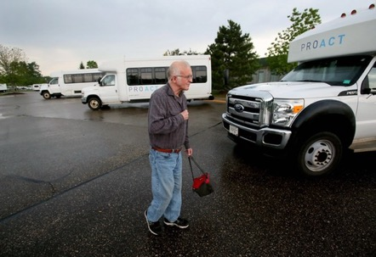
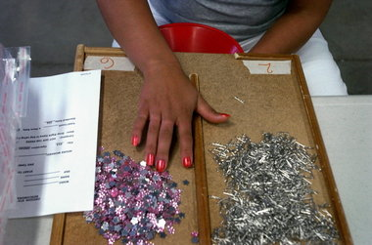
Need Special Places and
Special Programs for
Special People
12

Slide 12
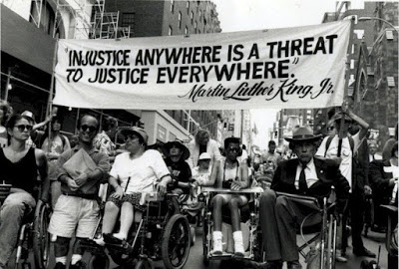
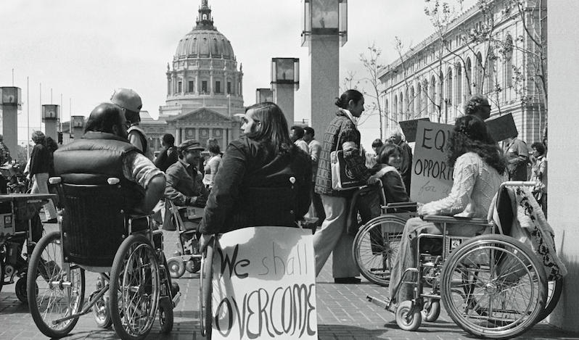
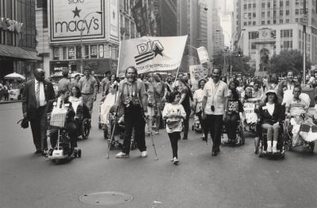
Disability Rights Movement

Slide 13
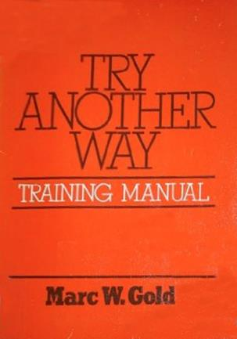
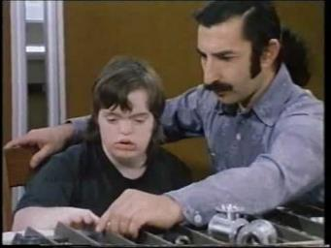
Try Another Way

Slide 14

Supported Employment Emerges
People with significant disabilities can work successfully…but only with significant on-the-job professional supports
It’s assumed employers are unwilling and incapable of providing necessary supports
Physical presence by individual in workplace is deemed sufficient

Slide 15

1972

Slide 16
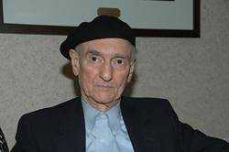

Wolf Wolfensberger
Need physical integration for social integration
However, physical integration is not enough
“Ultimately, integration is only meaningful if it is social integration; i.e., if it involves social interaction and acceptance, and not merely physical presence.”

Slide 17

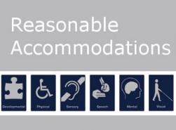

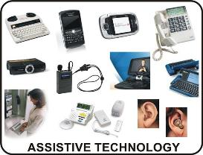
I990’s
Natural Supports
Person-Centered Planning

Slide 18

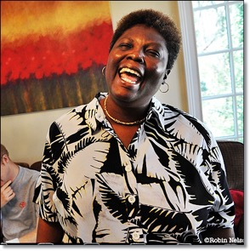


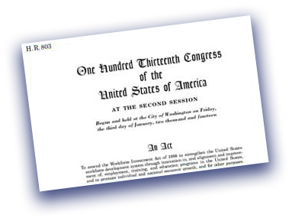
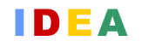

Evolving Policies
and Work Incentives Improvement Act
1999
Olmstead Decision
1999
1990
Individuals with Disabilities Education Act
1990
Workforce Innovation & Opportunity Act
2014

Slide 19

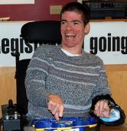
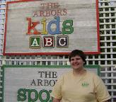
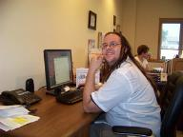
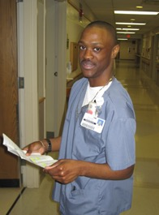
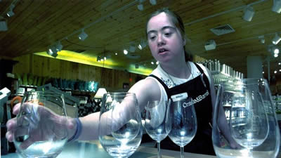
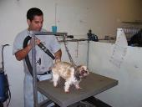
Disability Employment: 21st Century View
Disability: not a barrier to employment in
general workforce
Right job match and supports = job success
Full integration and inclusion

Slide 20

We should applaud our progress.
YET…
We need to do better

Slide 21
We are of good intent, BUT we are also victims of….
Outdated thinking
Lack of knowledge of best practices
Comfort with the way things are
Systems that reinforce traditional services and supports
A highly ableist society

Slide 22
Ableism
Bias, prejudice, and discrimination against people with disabilities
Based on idea that people with disabilities are less valuable than nondisabled people

Slide 23
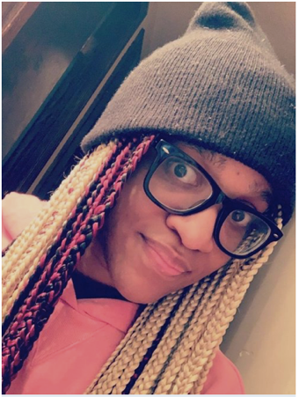
Kamisha Heriveaux
“Society is always putting people with disabilities down: ‘You can’t do this.’
So it impacts people’s thoughts.
They start thinking to themselves,
‘Oh, is this what they said true about me?’
So that’s why they don’t pursue what they really want to pursue because society leaves a bad taste in their mouth.”

Slide 24
We need to be a force for combatting ableism

Slide 25
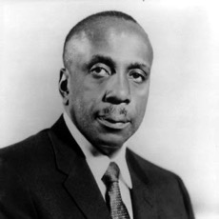
“Meaningful and creative shared experiences shared between people can be more compelling than all of the faiths, fears, concepts, ideologies, and prejudices that divide; and if these experiences can be multiplied and sustained over a sufficient duration of time, then any barrier that separates one person from another can be undermined and eliminated.”
Howard Thurman

Slide 26
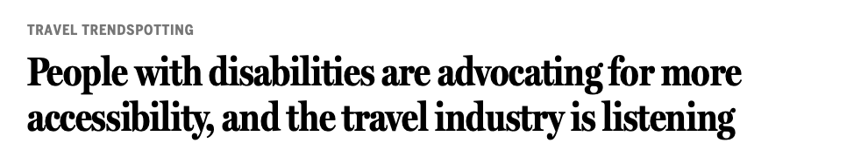
“Many of these improvements have come thanks to the disabled community’s own growing activism and that of allies more exposed than earlier generations to disabled classmates and colleagues at school and work, and disabled characters in popular culture."

Slide 27
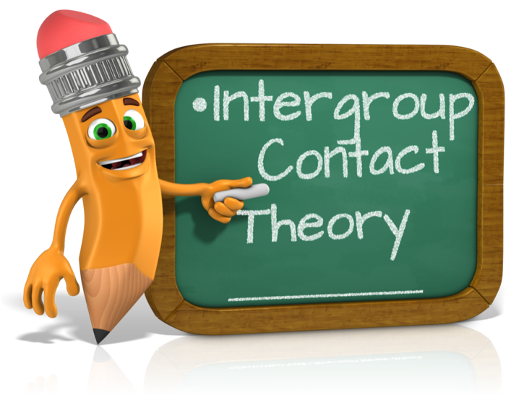
Intergroup Contact Theory
Developed by Gordon Allport in 1954
Personal contact with members of a negatively stereotyped group generally improves attitudes toward group members
Not all such contact will necessarily have a positive outcome
  Certain optimal conditions needed for the contact situation

Slide 28

Characteristics of a Socially Valued Employee
Source:
Tyree, Kendrick, and Block, 2011
Supports or adaptations provided for worker in ways as typical as possible
Opportunities for a “normative” quantity of interactions with non-disabled employees
Person is clearly in the role of a valued employee and viewed as competent
The particular work responsibilities and place of employment are socially valued
If multiple people with disabilities are employed in same business they are in individual, personalized jobs and not grouped together

Slide 29
People and organizations do not always know they are thinking or acting in an ableist way

Slide 30
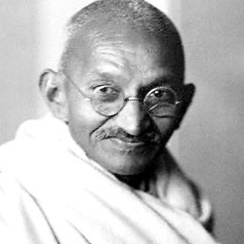
Mahatma Gandhi
“Be the change you
want to see in the
world.”

Slide 31
“Key blockages to disability inclusive employment include entrenched negative assumptions about disabled people's entitlement and suitability to work.”
Achieving disability inclusive employment – Are the current approaches deep enough?
- Institute of Development Studies. 2022

Slide 32
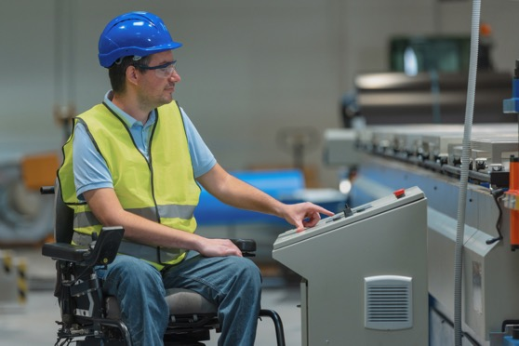
Do we automatically view people with disabilities as capable?

Slide 33
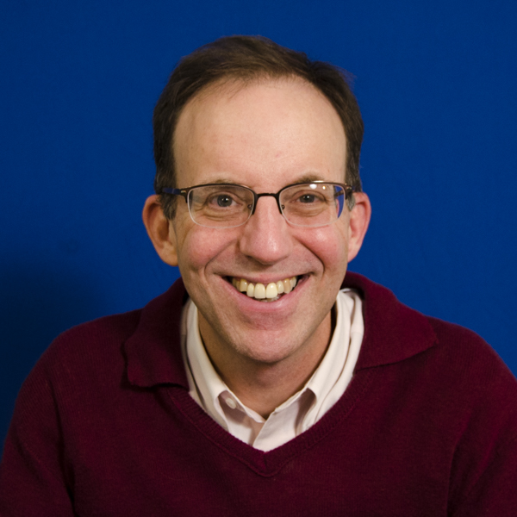
Avoid the employment readiness myth
Employers are expecting perfect employees

Slide 34
No More “Othering”
People with disabilities need to be seen as full citizens who are automatically ‘in’ and have a right to expect to be in, rather than outsiders who need to earn their way in
Habitual othering needs to be challenged and addressed, so people with disabilities become regarded as full and autonomous citizens
From: Achieving disability inclusive employment – Are the current approaches deep enough?
- Institute of Development Studies, 2022

Slide 35


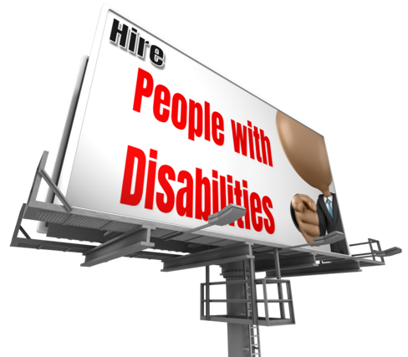
Marketing and Outreach
What’s the message?
Are we marketing “disability” or “capability”?

Slide 36
Ableist employer outreach and job development
Employees with disabilities are more reliable, compliant, loyal
Happy doing mundane and repetitive tasks
People with disabilities are good at certain types of jobs
Personality traits of people with disabilities make them excellent employees
Neurodivergent individuals have “super abilities”

Slide 37
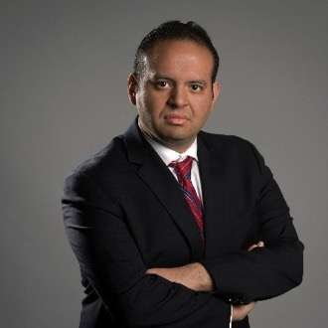
Eric Michael Garcia
Author: We’re Not Broken: Changing the Autism Conversation
“I would love to live in a
world where autistic
people don’t have
to count cards to be loved.
I would love for us not to
have a superpower.”

Slide 38
Avoiding “Disability” Jobs
Jobs that are deemed “suitable” for people with disabilities based on their impairment, reduces choice and opportunities
Instead, jobs should be adapted and adjusted so that people who meet the position qualifications and happen to have various characteristics can do them with appropriate support
From: Achieving disability inclusive employment – Are the current approaches deep enough?
Institute of Development Studies, 2022

Slide 39

People hired on merit
Not charity
Not “token” jobs
Not “social responsibility”

Slide 40
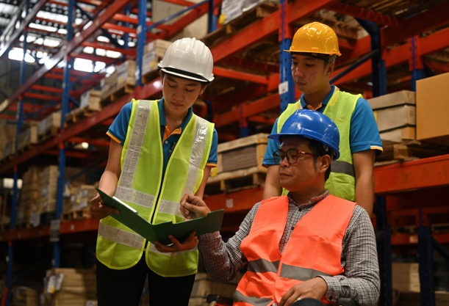


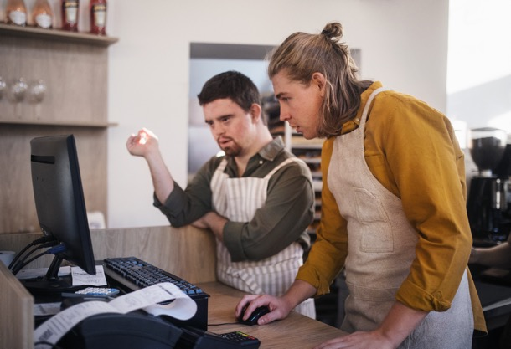
Countering employer ableism and perceived skill/ability gaps

Slide 41
Filling the Gap
Employer Needs
Job Requirements
Good job matching
Accommodations
Assistive technology
Quality job coaching
Short-term job tryouts/internships
Increasing job skills of job seeker through education
Job creation
Job carving
Business within a business
Others
Employer Needs
Perception of skills & abilities
Perception of skills & abilities

Slide 42
We need to recognize the inherent uneven power dynamics and challenges caused by ableism and our service designs

Slide 43
Choices and Decision-Making
Are we truly allowing and supporting individuals to make their own choices and decisions?

Slide 44
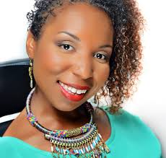
Andraéa LaVant
Impact Producer, Crip Camp
“Everybody else in life gets the
opportunity to make mistakes.
You go out on your own, but because disabled people are often sheltered and other people are making decisions for us,
we don't have those opportunities to live completely wholly in that way.”

Slide 45
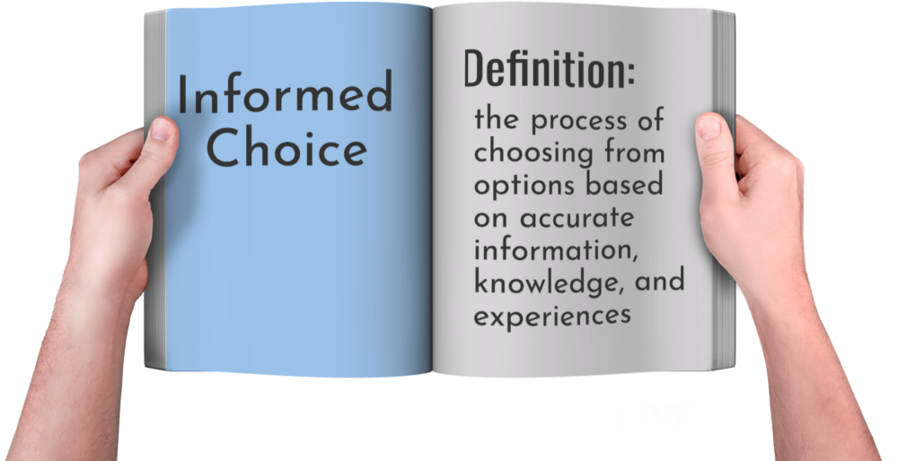
Informed Choice Definition

Slide 46
Steps for Informed Choice & Employment
Provide information about benefits of working in the community
Facilitate visits or other experiences with employers and businesses
Peer-to-peer discussions
Identify & address any concerns or objections raised by individual or relevant decision maker
Regularly revisit decision not to work in the community

Slide 47

“Nothing
About Us
Without Us”
We need to constantly challenge themselves:
Are people with disabilities present?
If not, why not?
Are people with disabilities in
decision-making roles?
Are people with disabilities in leadership roles?
Are professional staff “in charge” or are they in support roles?

Slide 48
Gut Check: Nothing About Us Without Us
Do staff represent people with disabilities to employers only as necessary?
Are people with disabilities leading person-centered planning?
Are people with disabilities fully engaged in decisions and decision-makers about:
  job exploration/discovery sites?
  positions they are applying for?
  types and level of job supports?
  services they are receiving?
Does the organization ”practice what we preach” and employ people with disabilities?
Are people with disabilities on the organization’s board?

Slide 49

Supporting a Culture of Disability Pride

Slide 50

Competitive Integrated Employment is the
Gold Standard
Anything that deviates from
that may be considered ableist

Slide 51

Whenever we deviate from the typical non-disabled process in terms of job search, structure/elements of a position, and job supports we should always ask ourselves...

Slide 52
Do special employment
“programs” and employer disability
“projects” reinforce ableism?

Slide 53
Social Enterprises:
The Ableism Challenge
Does the nature of the social enterprise limit views of individual capabilities and employment opportunities…by the individual themselves, family members, service provider, general public?
Does it potentially reinforce stereotypes and presumptions about people with disabilities?
Why create a social enterprise instead of supporting individuals to find employment in the general workforce?

Slide 54
IF you’re going to have a social enterprise…
Be very clear regarding goals, purpose, target population, and role in career pathway
Base it on the vision, needs, preferences of individuals
People with disabilities in leadership, supervisory, and advisory positions
Opportunities for ownership, equity stake, and profit sharing for people with disabilities
Avoid business names, signage, and marketing that reinforce an ableist message of charity, pity, ”less than”

Slide 55

Final Thoughts

Slide 56
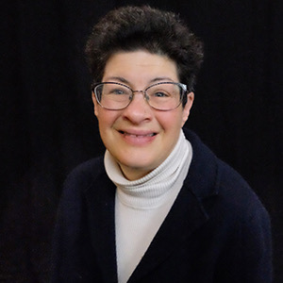
Liz Weintraub:
“People without disabilities need to believe in people with disabilities, support their dreams, and believe that people can have jobs.”

Slide 57
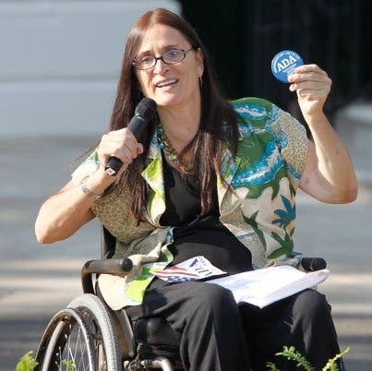
Marca Bristo
“The change takes place on an individual level and it takes place on a societal level, but it all starts with empowering individuals with disabilities to change the way they think about themselves, to cast away the stereotypes that confine us, to find their voice, and to become actively involved in social change."

Slide 58
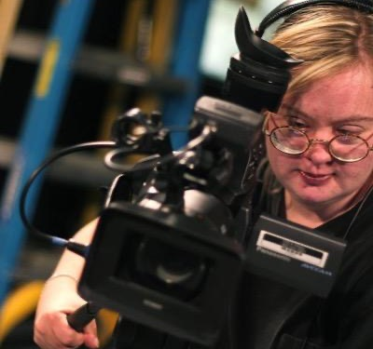
“Listen to our dreams about having a job.
We want to work just like others.”
Stirling Peebles
University of Vermont
Green Mountain Self-Advocates

